Slide 1
The Cattle Industry 1867-1887 (20 years)
Important Vocabulary

Slide 2
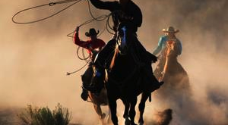
cattle industry
the industry that included the driving of cattle to railheads in order to sell beef to eastern and western city markets.

Slide 3
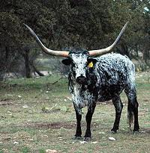
Longhorn cattle
cattle in Texas
that had a horn
span of 6-7 feet from the tip of one horn to the next;

Slide 4
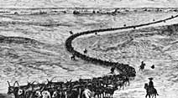
cattle drive
the movement of herds of cattle from the southern portion of Texas to railheads to the north

Slide 5
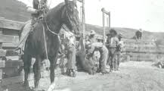
ranchers
the men who owned the cattle and paid others to drive the cattle to northern markets

Slide 6
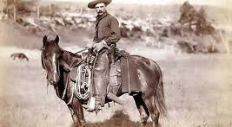
cowboys
the men paid to drive the cattle to markets in the north

Slide 7
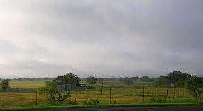
open range
the wide-open spaces of Texas where cattle were driven to markets in the north

Slide 8
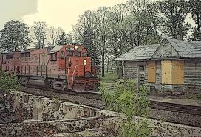
railhead
the town where cattle drives ended; railroads ran through these towns to transport cattle to eastern and western markets

Slide 9
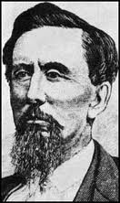
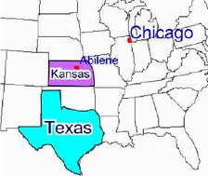
Joseph McCoy
the man who created the railhead, Abilene, Kansas, in order to make a profit in the beef industry

Slide 10
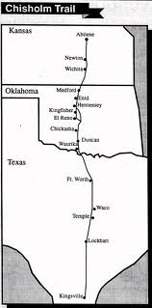
Chisholm Train
the cattle trail that began in the southern tip of Texas and ended at the railhead, Abilene, Kansas.

Slide 11
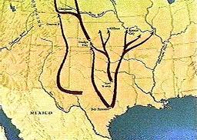
Great-Western Trail
the cattle trail that began in southern Texas and ran to the railhead, Dodge City, Kansas.

Slide 12
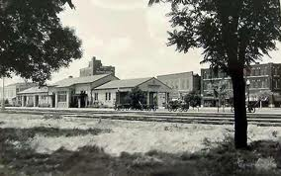
Abilene, Kansas
the railhead of the Chisholm Trail

Slide 13
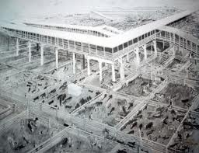
stockyard
the large pens where cattle were stored until they were slaughtered and shipped to eastern and western markets

Slide 14
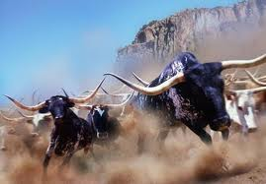
stampede
a sudden, frenzied rush or headlong flight of a herd of frightened animals, especially cattle or horses.

Slide 15
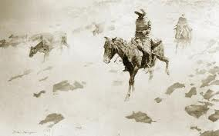
Great Die-up
the severe blizzard that caused thousands of cattle to freeze to death; the cattle industry changed after this blizzard

