Slide 1
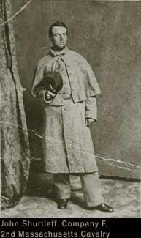
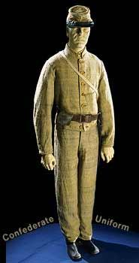
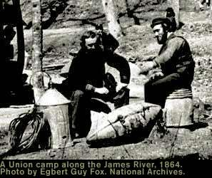
STUDY GUIDE for CAUSES OF THE CIVIL WAR!

Slide 2
THE MISSOURI COMPROMISE (1820)
There was a great debate over where slavery would be allowed and if Missouri would join the North or South. A debate occurred and finally a compromise was reached. It stated:
Missouri = slave state (South) and Maine = free state (North)
Any states in the Louisiana Territory NORTH of the Missouri Compromise Line will be FREE
Any states in the Louisiana Territory SOUTH of the Missouri Compromise Line will be SLAVE
The 36’ 30’’ line is drawn.
Compromise lasted almost thirty years! However, after about 1850, problems began to occur...

Slide 3
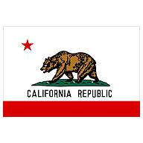
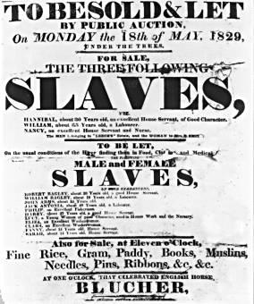
COMPROMISE OF 1850
1.) California enters as a FREE state.
2.) Area from Mexican Cession divided into Utah and New Mexico. Slavery issue to be decided by POPULAR SOVEREIGNTY.
3.) ENDED slave trade in Washington D.C.
4.) Made a STRICT Fugitive Slave Law - Runaway Slaves to return to south
5.) Settled border problems between New Mexico and Texas.
Again, problems better for about four years, and then became worse...

Slide 4
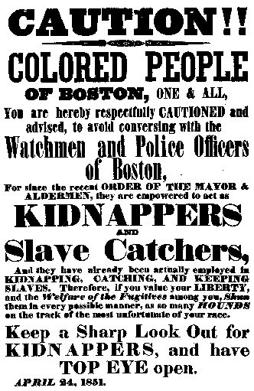
FUGITIVE SLAVE LAW (1850)
REQUIRED citizens to catch runaway slaves.
If a person did not comply, they could be fined up to $1000 or put in jail for SIX months.
MANY free slaves were captured and sent back into slavery.
Northerners HATED this law because it forced them to become a part of the system of slavery.
http://search.eb.com/blackhistory/micro/222/8.html

Slide 5
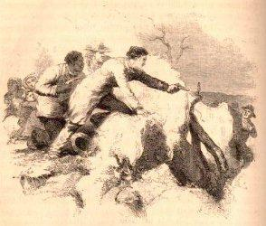
UNCLE TOM’S CABIN (1852)
NOVEL written by Harriett Beecher Stowe.
Showed the EVILS of slavery by telling the story of an older slave who was whipped to death by his owner.
After reading it, MANY Northerners began to change their view of slavery.
Southerners said the book was full of LIES! It was banned in the South.

Slide 6
KANSAS-NEBRASKA ACT (1854)
Democratic senator Stephen A. Douglas of Illinois sponsored this bill.
Divides lands into Kansas and Nebraska territories.
Decided that SLAVERY issue would be decided by POPULAR SOVREIGNTY.
Led to violence in the Senate.
Pro-slavery and Anti-slavery settlers in ONE AREA and this leads to conflict!
Northerners believe this REPEALS the Missouri Compromise.

Slide 7
DRED SCOTT DECISION (1857)
Dred Scott was a slave.
He had lived in a free territory with his owner.
His owner moved back into a slave state.
While there, the owner died.
Scott had ABOLITIONIST attorneys file a lawsuit for him.
It went to the Supreme Court but he LOST.
The Court ruled he was NOT a citizen but RATHER property and therefore he could not file a lawsuit.
Also, they ruled that Congress could NOT ban slavery in any of the territories.
This REPEALED the Missouri Compromise.
Southerners LOVED the ruling while Northerners HATED it. It meant slavery could spread into all the territories!
http://encarta.msn.com/media

Slide 8
LINCOLN-DOUGLAS DEBATE (1858)
Lincoln and Douglas debated!
Douglass believed in deciding slavery by popular sovereignty.
Lincoln believed that slavery should NOT be allowed to spread into the territories.
Lincoln ALSO believed the Nation could not survive if the fighting continued to rip the Union apart with the slavery issue.
Lincoln lost the bid for Senator from Illinois. Douglas won.

Slide 9
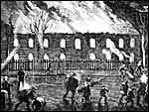
RAID ON HARPER’S FERRY (1859)
John Brown led five blacks and thirteen whites into Harper’s Ferry.
They planned to raid an arsenal and start a slave revolt.
Problem: No slaves “rose” to help.
A number of his men died and Brown was arrested by Robert E. Lee.
Brown was tried and found guilty of murder and treason. He was later hanged.
Some Northerners thought of him as a “Martyr” (someone who dies for his beliefs.)

Slide 10
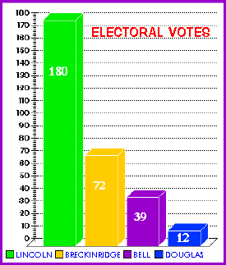
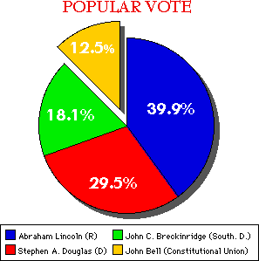
ELECTION OF 1860
Lincoln ran against Douglass in the Presidential Election of 1860.
The Southern states did not like Lincoln or what he believed in. They overwhelmingly supported Douglass yet Lincoln STILL got elected.
Southerners grew very angry. Said this showed it did not matter what their opinions were, the North had too much power!
Many Southerners talked of SECEDING from the Union.
http://www.multied.com/elections/1860.html

Slide 11
IMPORTANT VOCABULARY!
POPULAR SOVEREIGNTY –
A VOTE where the people decide on an issue. (I.E. – slavery)
COMPROMISE –
An agreement reached between two sides where both sides have to “give up” something,.

Slide 12
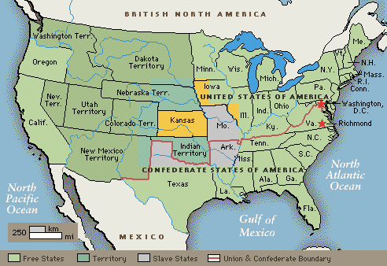
MORE VOCAB. -
ABOLITIONIST –
A person who works to bring an end to or believes in NO slavery. Often they try and help slaves to freedom.
SECTIONALISM –
The belief that your part of the country is the BEST. You put your part of the country’s needs in front of what is best for the WHOLE nation.
/encarta.msn.com/media

Slide 13
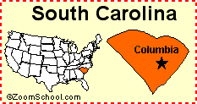
MORE VOCAB.
FUGITIVE –
A person who has gone against or broken the law and is on the run.
SECEDE -
To remove or break away as the Southern states did from the Union.
STATES’ RIGHTS: states decide, not the federal government, what is right for their state

Slide 14
More Vocab!
Free state-a state that did not allow slavery
Slave State- a state that allowed slavery to be used

Slide 15
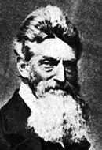
LAST TWO!
ARSENAL –
A warehouse that stores guns and ammunition.
MARTYR –
A person who is willing to die for their beliefs. I.E. – John Brown

