Slide 2
???
???
???
???
???
100
100
100
100
100
200
200
200
200
200
300
300
300
300
300
400
400
400
400
400
500
500
500
500
Final
Notes:
*

Slide 3
Vocabulary
People
Battles
Events and
People
North/South
100
100
100
100
100
200
200
200
200
200
300
300
300
300
300
400
400
400
400
400
500
500
500
500
500
Notes:
*

Slide 4
William Lloyd Garrison, Harriet Beecher Stowe, and John Brown were just 3 of these people.
Notes:
*

Slide 5
What are abolitionists?
Notes:
*

Slide 6
The North and South differed in their economic ways. The North was more industrial while the South was more agricultural. The South’s major income source was from…
Notes:
*

Slide 7
What is cash crops?
Notes:
*

Slide 8
This type of state did not allow slavery.
Notes:
*

Slide 9
What is a free state?
Notes:
*

Slide 10
This was an agreement made between the opposing parties in Congress. Each agreed to give up a little of what they truly wanted.
Notes:
*

Slide 11
What is a compromise?
Notes:
*

Slide 12
The North imposed a tax on imported goods. This tax was called a/an…
Notes:
*

Slide 13
What is a tariff?
Notes:
*

Slide 14
This person appealed to the Supreme Court for his and his wife’s freedom because he had lived on free soil while his master was still alive.
Notes:
*

Slide 15
Who was Dred Scott?
Notes:
*

Slide 16
Uncle Tom’s Cabin was written by this person whom Lincoln remarked, “So this is the little lady who started this war.”
Notes:
*

Slide 17
Who was Harriet Beecher Stowe?
Notes:
*

Slide 18
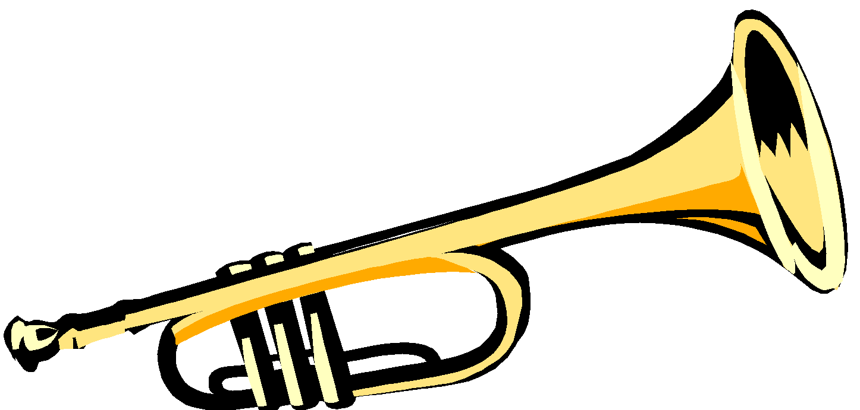
DAILY DOUBLE
DAILY DOUBLE

Slide 19
This general led his troops through Atlanta to Savannah and destroyed everything in his path.
Notes:
*

Slide 20
Who was General William “Tecumseh” Sherman?
Notes:
*

Slide 21
This man became the President of the Confederate States of America even though he did not want the office.
Notes:
*

Slide 22
Who was Jefferson Davis?
Notes:
*

Slide 23
He became the leader of the Union troops in 1864 after many failures of other Union generals.

Slide 24
Who was Ulysses S. Grant?
Notes:
*

Slide 25
The battle where “Stonewall” Jackson got his nickname.
Notes:
*

Slide 26
What was the First Battle of Bull Run?
Notes:
*

Slide 27
What Sherman did as he marched his troops from Atlanta to Savannah.
Notes:
*

Slide 28
What is burn, destroy, and ransack all Confederate resources? (total war)
Notes:
*

Slide 29
The reason Atlanta was burned to the ground by General Sherman.
Notes:
*

Slide 30
What is it was the key city in Georgia that contained factories, banks, and railroads that could replenish the South’s resources?
Notes:
*

Slide 31
This battle lasted for 33 hours and was the first victory of the Civil War for the Confederacy.
Notes:
*

Slide 32
What was the battle of Fort Sumter?
Notes:
*

Slide 33
A Union victory that ensured all remaining battles of the Civil War would be fought on southern soil.
Notes:
*

Slide 34
What was the “turning point” of the war? (the Battle of Gettysburg)
Notes:
*

Slide 35
I got my nickname because I would not take any conditions before the enemy surrendered.
Notes:
*

Slide 36
Who was Ulysses S. Grant?
Notes:
*

Slide 37
I was elected to the Presidency of the United States in 1861.
Notes:
*

Slide 38
Who was Abraham Lincoln?
Notes:
*

Slide 39
I turned down Abraham Lincoln’s offer to lead his Union troops because I loved my state of Virginia, which seceded from the Union.
Notes:
*

Slide 40
Who was Robert E. Lee?
Notes:
*

Slide 41
I tried to steal weapons from a military armory in order to arm slaves in a rebellion against their masters.
Name and place!
Notes:
*

Slide 42
Who was John Brown at Harper’s Ferry, Virginia?
Notes:
*

Slide 43
I accepted the surrender of the Confederate general who led the troops for the Army of Northern Virginia.
Notes:
*

Slide 44
Who was Ulysses S. Grant?
Notes:
*

Slide 45
This side had the best military leadership when the Civil War began.
Notes:
*

Slide 46
What was the Confederacy?
Notes:
*

Slide 47
An advantage of being able to fight on their own land because it was familiar territory.
Notes:
*

Slide 48
What was the South?
Notes:
*

Slide 49
The condition that allowed Confederate soldiers to be able to go home and plant their crops after the surrender of Lee to Grant.
Notes:
*

Slide 50
What was “all Confederate soldiers may take their horses back home”?
Notes:
*

Slide 51
The condition given by Grant to Confederate officers.
Notes:
*

Slide 52
What is “they could keep their swords”?
Notes:
*

Slide 53
Where the surrender of Lee to Grant took place.
Notes:
*

Slide 54
What is Appomattox Courthouse?
Notes:
*

Slide 55
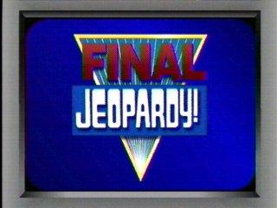

Slide 56
Why Grant instructed his Union troops not to cheer at the surrender at Appomattox Courthouse.
Notes:
*

Slide 58
What is not allowing his Union troops to cheer and jeer at the Confederate soldiers because they were not all countrymen.
Notes:
*

