Slide 1
Figurative
Language
Fun and Interactive
Created by
TEACHERS UNLEASHED

Slide 2
What is Figurative Language?
Whenever you describe something by comparing it with something else, you are using figurative language!
There are many different kinds of figurative language: similes, metaphors, hyperboles, and personification are just some of the ones you might know!
Let’s take a closer look!

Slide 3
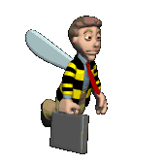
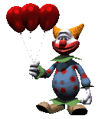
What is a simile?
A simile uses the words “like” or “as” to compare one object with another to suggest they are alike or similar.
Example: He was busy as a bee.
Example: She was silly like a clown.

Slide 4
What is a metaphor?
A metaphor is like a simile. It compares two things, but DOES NOT use the words like or as. A simile would say you are like something, and a metaphor would say you are something.
Example: Her eyes were jewels, sparkling in the sun.
Example: The bottom of the ocean is a dark cave.

Slide 5
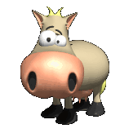
What is a hyperbole?
A hyperbole is an exaggeration that is so dramatic that no one would believe the statement is true.
Example: He was so hungry, he ate the whole cow for lunch, tail and all.
Example: “I don’t have time to do my chores, I already have a million things to do!

Slide 6
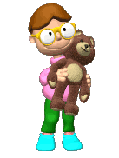
What is a personification?
Personification is where human characteristics are given to an animal or an object.
Example: My teddy bear gave me a hug.
Example: The flowers danced in the breeze.

Slide 7
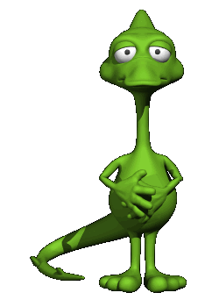
Now, let’s see if you can identify figurative language on your own.

Slide 8
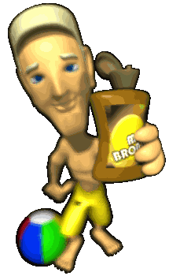
Look at the sentence….see if you can decide what type of figurative language it is!
His skin was tan like the sand in the desert.
Simile: It uses the word “like” to compare the color of his skin to sand.

Slide 9
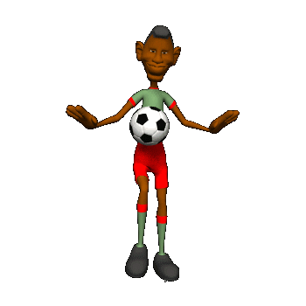
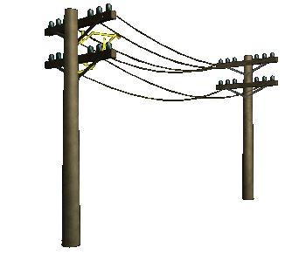
Look at the sentence….see if you can decide what type of figurative language it is!
My brother is so skinny, he could be a telephone pole.
Hyperbole: This is an exaggeration! No one is as skinny as a telephone pole.

Slide 10
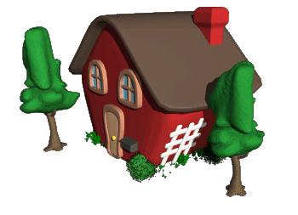
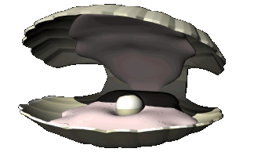
Look at the sentence….see if you can decide what type of figurative language it is!
After we moved out, our house was an empty shell.
Metaphor: This sentence is comparing a house to a empty shell.

Slide 11
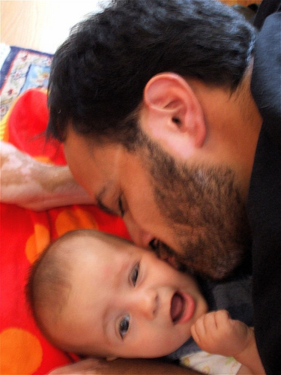
Look at the sentence….see if you can decide what type of figurative language it is!
My dad’s beard was itchy sand paper.
Metaphor: This sentence is comparing dad’s beard to itchy sand paper.

Slide 12
Look at the sentence….see if you can decide what type of figurative language it is!
The Sun said, “Hello,” as it came up over the horizon.
Personification: The sun cannot really say hello, it is giving human characteristics to the Sun.

Slide 13
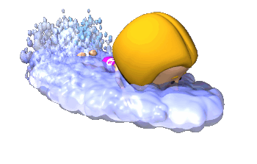
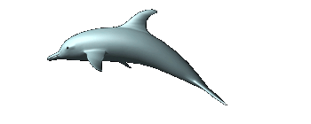
Look at the sentence….see if you can decide what type of figurative language it is!
Emily swam like a dolphin in the pool.
Simile: It uses the word “like” to compare Emily to a dolphin.

Slide 14
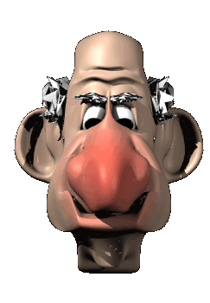
Look at the sentence….see if you can decide what type of figurative language it is!
My grandpa’s nose is so big, he could smell the flowers from miles away.
Hyperbole: It is an exaggeration. No one’s nose could smell flowers from miles away.

Slide 15
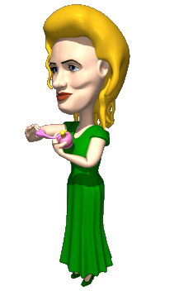
Look at the sentence….see if you can decide what type of figurative language it is!
My mom’s perfume was like sweet roses in bloom.
Simile: It is comparing Mom’s perfume to roses using the word “like”.

Slide 16
Look at the sentence….see if you can decide what type of figurative language it is!
The popcorn jumped in my mouth so fast that I ate the whole bowl.
Personification: Popcorn cannot really jump into your mouth. It is giving human characteristics to popcorn.

Slide 17
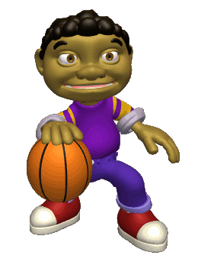
Look at the sentence….see if you can decide what type of figurative language it is!
Paul was a shining star at the basketball game.
Metaphor: It is comparing Paul to a shining star, without using like or as.

Slide 18
Look at the sentence….see if you can decide what type of figurative language it is!
My pencil was as sharp as a razor, slicing the paper with every move.
Simile: This sentence is comparing a pencil to a razor using the word “as”.

Slide 19
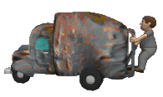
Look at the sentence….see if you can decide what type of figurative language it is!
My husband’s feet were so smelly, I thought garbage trucks were in the house.
Hyperbole: This is an exaggeration. No one’s feet could smell as bad as a garbage truck.

Slide 20
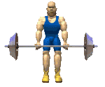
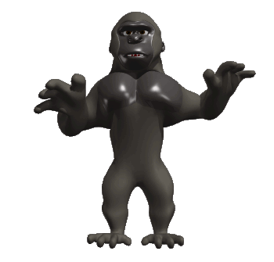
Look at the sentence….see if you can decide what type of figurative language it is!
The body builder was as strong as a King Kong.
Simile: This sentence is comparing a body builder to King Kong using the word “as”.

Slide 21
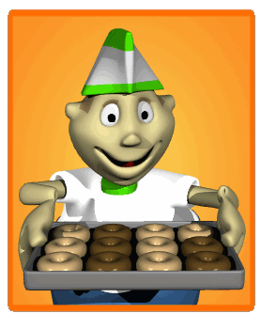
Look at the sentence….see if you can decide what type of figurative language it is!
I was so hungry, I could have eaten a million donuts.
Hyperbole: This is an exaggeration. No one could eat a million donuts.

Slide 22
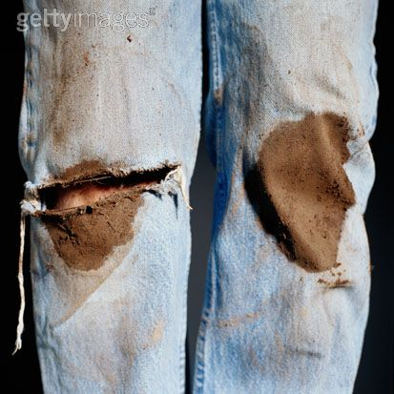
Look at the sentence….see if you can decide what type of figurative language it is!
I got so dirty, that my pants screamed “clean me!”
CLEAN ME!!
Personification: This sentence gives human characteristics to pants. Pants cannot scream.

Slide 23
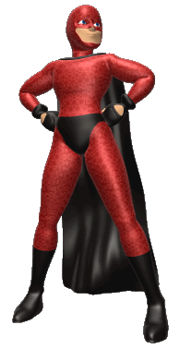
Look at the sentence….see if you can decide what type of figurative language it is!
He could leap tall buildings in a single bound!
Hyperbole: Jumping over a building is just not possible.

Slide 24
Look at the sentence….see if you can decide what type of figurative language it is!
Her lips were red like ripe cherries.
Simile: This sentence is comparing lips to cherries using the word “like”.

Slide 25
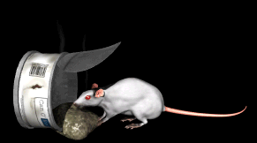
Look at the sentence….see if you can decide what type of figurative language it is!
The pirates were dirty rats floating in the water.
Metaphor: It compares a pirate to a rat, without using like or as.

Slide 26
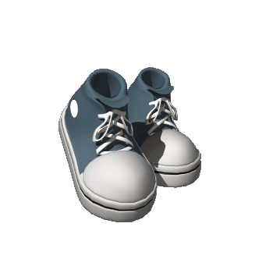
Look at the sentence….see if you can decide what type of figurative language it is!
The sneakers walked all the way to Alaska!
Personification: Sneakers cannot really walk.

Slide 27
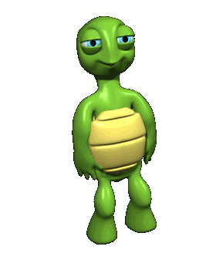
Look at the sentence….see if you can decide what type of figurative language it is!
When Sally Salamander smiled at Timmy Turtle, he was so embarrassed he thought he would die!
Hyperbole: This is an exaggeration, because no one can die of embarrassment.

Slide 28
Thank you for choosing
TEACHERS UNLEASHED
to help make your classroom
activities interactive and
exciting!
Check out our other creative
digital education products!
Our store website is:
www.teacherspayteachers.com/Store/Teachers-unleashed

