Slide 1
Steal Away Home
Chapter Vocabulary Words

Slide 2
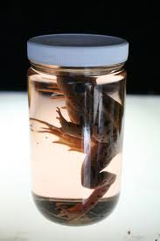
Chapter 1: “Tear Down the Wall”
Specimens
an individual item that represents
a whole.
Example: The frog specimens
were used to study the life-cycle of the frog.

Slide 3
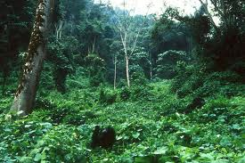
Chapter 1: “Tear Down the Wall”
impenetrable
impossible to pass through
or enter
Example: The forest was
an impenetrable area of
the far western region of
the country.

Slide 4
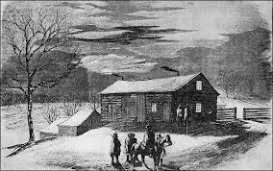
Chapter 2: “No Names”
hospitable
friendly and welcoming
to strangers and guests
Example: James’s mother
was hospitable to the fugitive slave family.

Slide 5
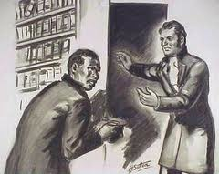
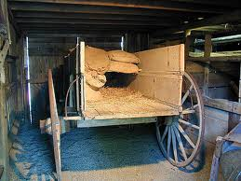
Chapter 2: “No Names”
harbor
to give shelter or protection
Example: The kind man
used his home to harbor
runaway slaves on their
way to freedom.

Slide 6
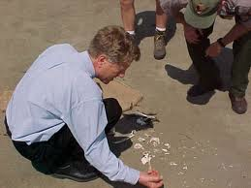
Chapter 3: “Identity Unknown”
coroner
a government official who
Investigates a human’s
death
Example: Dana’s mom knew the
coroner who was trying to
determine the cause of death
of the discovered
skeleton.

Slide 7
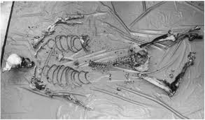
Chapter 3: “Identity Unknown”
autopsy
a medical examination of a
body to determine the cause
of death
Example: Dr. Baxi had to perform an autopsy on the skeleton in order to determine how the person in the secret room had died.

Slide 8
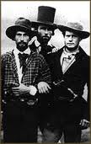
Chapter 4: “The Wakarusa War”
Border Ruffians
pro-slavery men from Missouri who
crossed into the Kansas territory to
stuff ballot boxes in favor of slavery
Example: The Border Ruffians made it
look like more people in Kansas wanted
slavery, when the truth was more Kansas
people were anti-slavery.

Slide 9
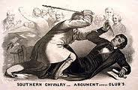
Chapter 4: “The Wakarusa War”
skirmishes
an unplanned set of fights
Example: Before The Civil War, Senators had many skirmishes about their different views on the issue of slavery.

Slide 10
Chapter 5: “The Night of the Living Bones”
pact
an agreement or understanding
Example: Dana’s parents made a pact
to let Dana keep the secret journal until July 1.

Slide 11
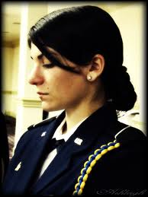
Chapter 5: “The Night of the Living Bones”
solemn
very serious
Example: Dana had to giver her solemn word that she would reveal the journal by July 1 if she had not solved the mystery of the skeleton.

Slide 12
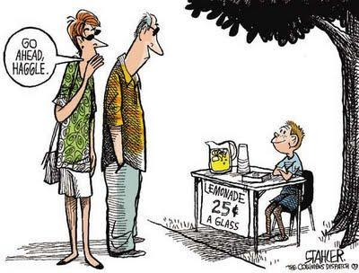
Chapter 6: “The Free-State Hotel”
haggling
to bargain or argue in a petty
manner
Example: Pa came home to Lawrence, Kansas, and told of how he and others had months of haggling over how to write the new state constitution for Kansas.

Slide 13
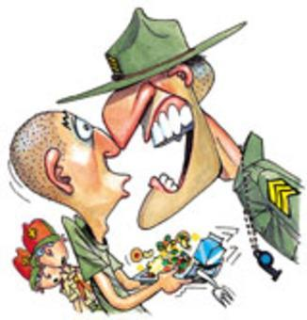
Chapter 6: “The Free-State Hotel”
brusquely
an abrupt or rough manner
Example: Pa spoke brusquely
when speaking of the problems of creating a new state constitution for Kansas.

Slide 14
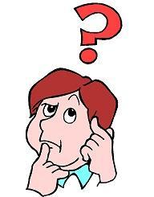
Chapter 7: “No Nancy Drews”
bamboozled
to deceive or get the better of
someone
Example: Dana’s parents knew that Dana and Ahn had bamboozled them when Dana and Ahn tried to sneak back to Dana’s bedroom.

Slide 15
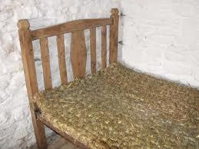
Chapter 7: “No Nancy Drews”
pallet
a mattress or bed made of straw
Example: Ma made a pallet for the
elderly runaway slave who visited
her home in the middle of the night.

Slide 16
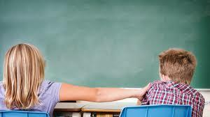
Chapter 8: “You Ain’t Seen Nothin’ Yet!”
provoke
to anger or enrage
Example: When James was walking home from school, his friends, Jeremy and Will, began to provoke him when they were boxing at his ears and shoulders.

Slide 17
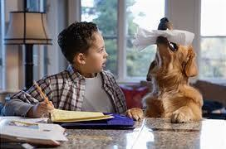
Chapter 8: “You Ain’t Seen Nothin’ Yet!”
diversion
a distraction from another
event
Example: As soon as James saw the crowd of men on Mount Oread, he used the crowd as a diversion to stop his friends from teasing him about Bethany.

Slide 18
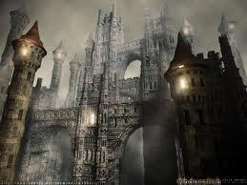
Chapter 9: “Edmund Wolcott’s Castle”
monstrosity
something that is
huge beyond belief
Example: Dana thought the Wolcott Castle was a monstrosity.

Slide 19
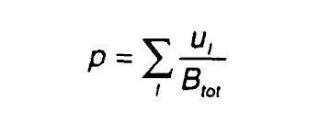
Chapter 9: “Edmund Wolcott’s Castle”
undecodable
a language, written or oral,
that cannot be
understood by others
Example: Dana’s parents had an undecodable way to communicate between themselves.

Slide 20
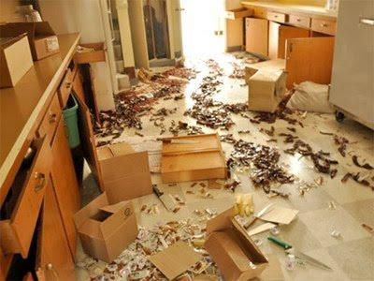
Chapter 10: “Thirty Cannonballs”
ransacked
to have been searched
thoroughly and vigorously
Example: The U.S. Marshal’s posse ransacked the Free State Hotel.

Slide 21
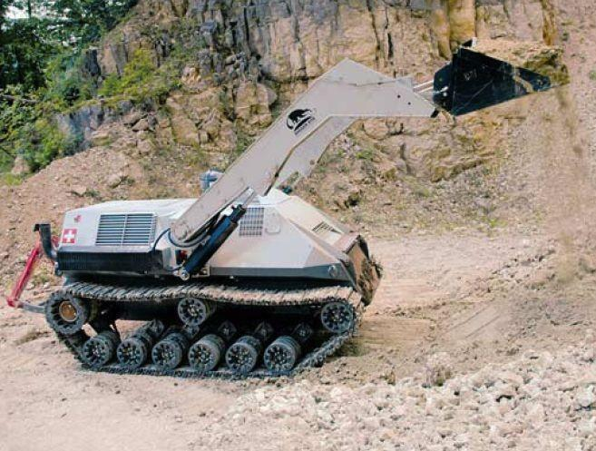
Chapter 10: “Thirty Cannonballs”
pulverizing
the act of pounding to
completely crush something
Example: Pa’s boots were pulverizing the clods of dirt in the road as he approached the town.

Slide 22
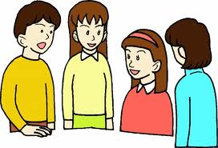
Chapter 11: “The Sack of Lawrence”
spontaneously
to act on something quickly
and decisively without thinking
beforehand
Example: Dana’s friends wanted to know if her house had spontaneously rebuilt itself.
The students had to spontaneously discuss the First Battle of Bull Run.

Slide 23
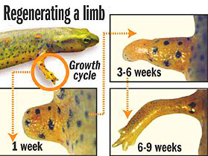
Chapter 11: “The Sack of Lawrence”
regenerated
to have reformed a broken
piece or part
Example: Dana’s friends laughed about the possibility of her her house having been regenerated.
A flatworm has regenerated its limb in 6-9 weeks.

Slide 24
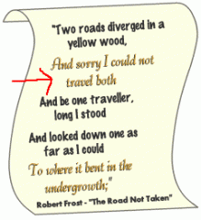
Chapter 12: “Follow the Drinking Gourd”
cadence
the rhythmic flow of words
Example: Lizbet Charles’s words about Henry Brown were spoken in cadence.
Poetry can have a sense of cadence when reading each stanza.

Slide 25
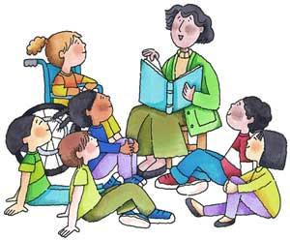
Chapter 12: “Follow the Drinking Gourd”
lured
being so interested in something
that someone else is doing that
you are tempted to listen and
learn
Example: James was lured into listening to Lizbet’s fascinating story.
The students were lured into the exciting story of the Civil War.

Slide 26
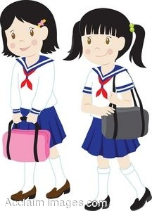
Chapter 13: “The Conductor”
unpardonable
not capable of being forgiven
Example: Dana’s friend, Mike,
spoke to Mrs. Shannon while she was driving them home, which was considered unpardonable.
School dress codes help students avoid wearing unpardonable clothes to school.

Slide 27
Chapter 13: “The Conductor”
etiquette
the use of good manners in all
situations
Example: Did Mike use good etiquette when he spoke to Dana’s mom while she was driving?
Saying “Please” and “Thank you” are examples of good etiquette.

Slide 28
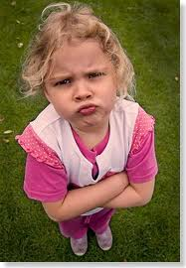
Chapter 14: “Three First Names”
indignantly
expressing strong displeasure with something
Example: Miss Lizbet spoke indignantly to James when he asked questions before listening to the entire story.
The little girl spoke indignantly to her older brother when he took away her favorite toy.

Slide 29
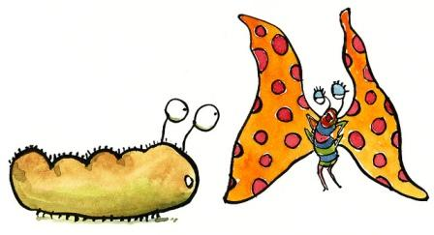
Chapter 14: “Three First Names”
transformed
having changed appearance
Example: Lizbet told the story of Miz Ellen Craft who transformed herself from a traveling gentleman to a beautiful woman in order to escape slave catchers.
A caterpillar is transformed into a colorful butterfly.

Slide 30
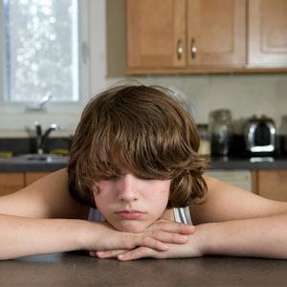
Chapter 15: “Uncle Mose”
sullen
gloomy silence
Example: Ma felt that James had become sullen since he had to keep secrets from Pa about Ma harboring runaway slaves.
The young boy became sullen when he found out he could not go to his friend’s house after school.

Slide 31
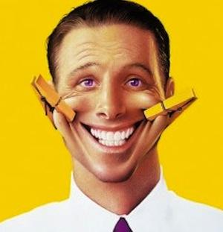
Chapter 15: “Uncle Mose”
feigned
having pretended something happened
Example: Miz Lizbet Charles told a story about a slaver who feigned a seizure while he was on the auction block.
The man feigned a smile by using clothes pins.

Slide 32
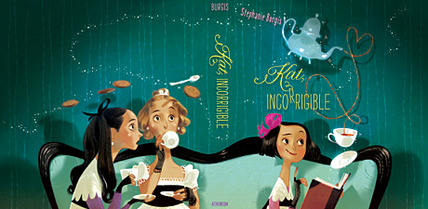
Chapter 16: “They Never Looked Back”
incorrigible
beyond change or reform
Example: Ma thought Pa was incorrigible when he continually teased her.
While the other ladies were acting properly, the little girl was being incorrigible.

Slide 33
Chapter 16: “They Never Looked Back”
warrant
a document that gives legal reason
for a person to be arrested
Example: The slave catcher produced a warrant to show he had the authority to arrest Solomon.
Police officers issue arrest warrants before bringing in a suspect.

Slide 34
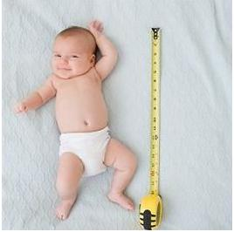
Chapter 17: “The View from Lizbet’s Cot”
growth spurt
a short period of time when a child
may grows quicker than what is
considered normal
Example: Dana informed Jeep that Miz Lizbet was an adult and had already gone through her growth spurt.
The baby had a growth spurt between doctor appointments.

Slide 35
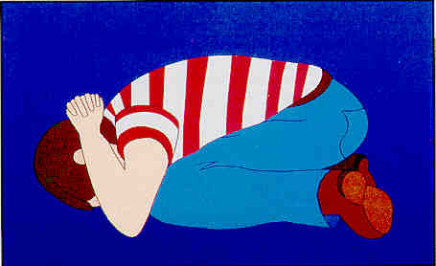
Chapter 17: “The View from Lizbet’s Cot”
crouched
to have bent close to the ground
Example: After rolling out from
under Lizbet’s cot, Jeep
crouched on the floor before he told
Dana he thought Lizbet had died in that room.
When practicing tornado drills, students are to be in a crouched position.

Slide 36
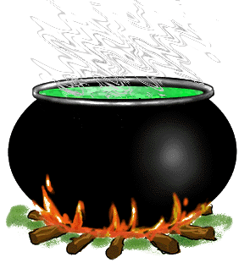
Chapter 18: “Like a Real Son”
cauldron
a large kettle
Example: Lizbet was boiling
Rebecca’s sick bed linens in
a cauldron.
There is a strange green liquid boiling in the black cauldron.

Slide 37
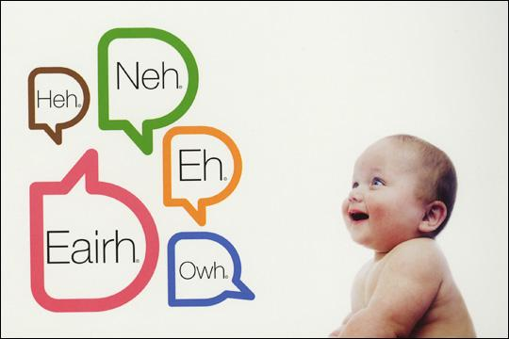
Chapter 18: “Like a Real Son”
gibberish
meaningless words that cannot
be understood
Example: James was studying
Algebra, and he thought all of it
was a bunch of gibberish.
Before babies speak real words that can be understood, their words sound like a whole bunch of gibberish.

Slide 38
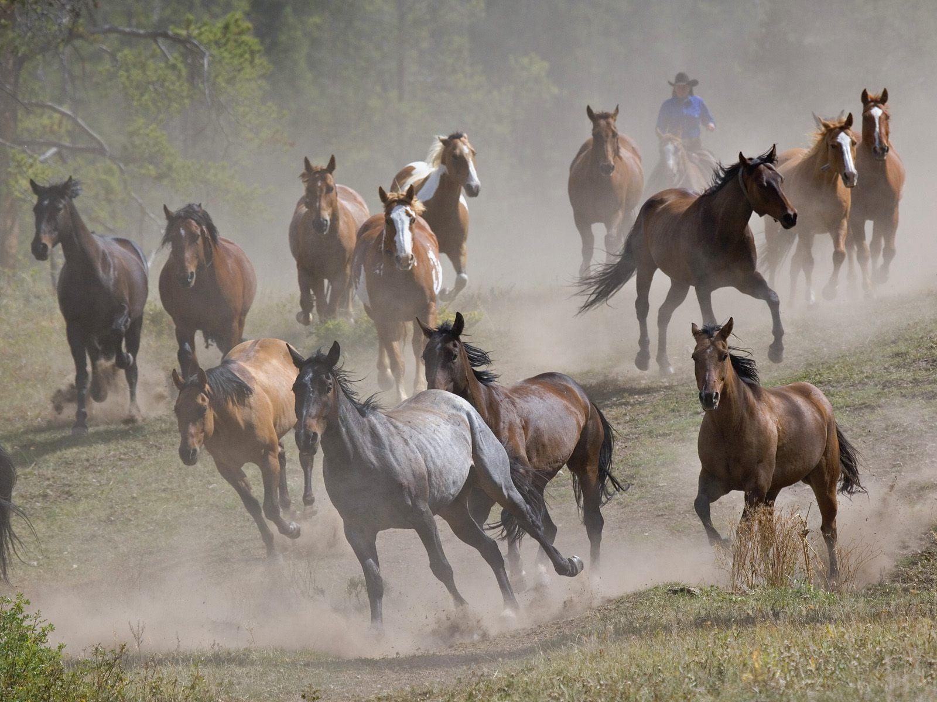
Chapter 19: “Plumb Crazy”
stampede
a sudden, uncontrollable running
of a herd of animals
Example: Because James was a
“city boy”, Jeremy teased him about being trampled in a stampede if James tried to be a cowhand who herded cattle.
The wild horses began to stampede when the cowboy tried to herd them into the canyon.

Slide 39
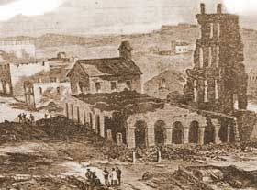
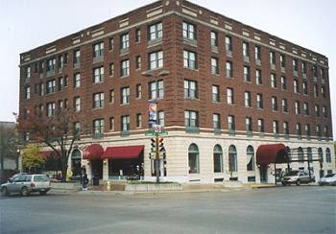
Chapter 19: “Plumb Crazy”
rechristen
to give a new name to something
Example: The Free State Hotel
was rechristened the Eldridge
Hotel.
The Free State Hotel was burned to the ground, but it was rebuilt and rechristened the Eldridge Hotel.

Slide 40
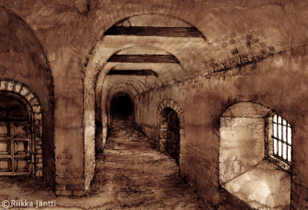
Chapter 20: “Tornado!”
dungeon
a strong, dark room located
underground
Example: During the tornado,
Dana had to hided in the basement,
which she considered a dungeon.
In Medieval times, a dungeon was used to hold prisoners.

Slide 41
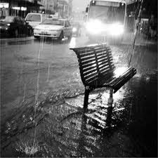
Chapter 20: “Tornado!”
ricochet
the motion of an object bouncing one or
more times from the surface over which it is passing
Example: The rain pellets fell and began to ricochet off the hoods of cars.
The rain began to ricochet off the pavement.

Slide 42
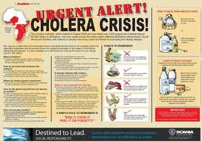
Chapter 21: “Wild Indigo”
cholera
an acute infectious disease
Example: An epidemic of cholera killed many people in the town of Lawrence.
Cholera can be still found today in third world countries.

Slide 43
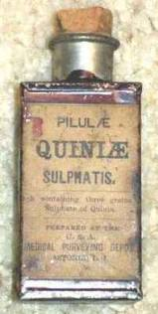
Chapter 21: “Wild Indigo”
quinine
a liquid that is used in medicine
to treat diseases, especially malaria
Example: Dr. Olney believed the quinine cured Rebecca of her fever, while Miz Lizbet believed it was the wild indigo root.
Quinine is a liquid sulfate used to treat malaria and other infectious diseases

Slide 44
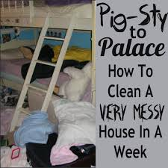
Chapter 22: “Hush Puppies”
pigsty
a slang word for a place that is extremely messy; like living in a pigpen
Example: Jeep did some research on Lawrence back in 1856 and found that the conditions of the town were like a pigsty and that is why the typhoid fever spread rapidly.
The room above is a pigsty! i

Slide 45
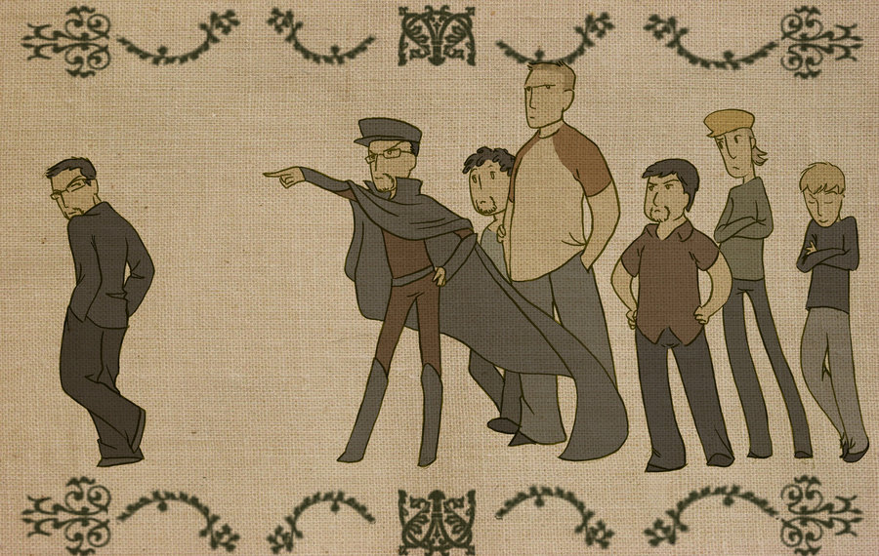
Chapter 22: “Hush Puppies”
banished
having been sent away
Example: Dana’s friends, Calvin and Luther, were banished to another table, where they proceeded to dump salt and pepper on that table.
The boy was banished from the group because he was being a bully.

Slide 46
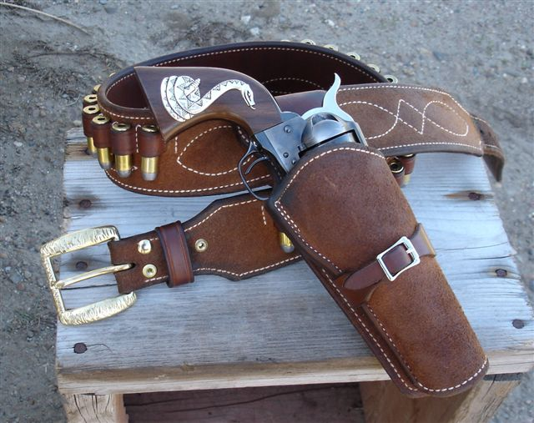
Chapter 23: “Will’s Quest”
holster
a carrying case for a firearm
Example: Will pulled his gun out of
the holster and twirled it around.
Cowboys wore their guns and holsters on their sides during the Cattle Trail era.

Slide 47
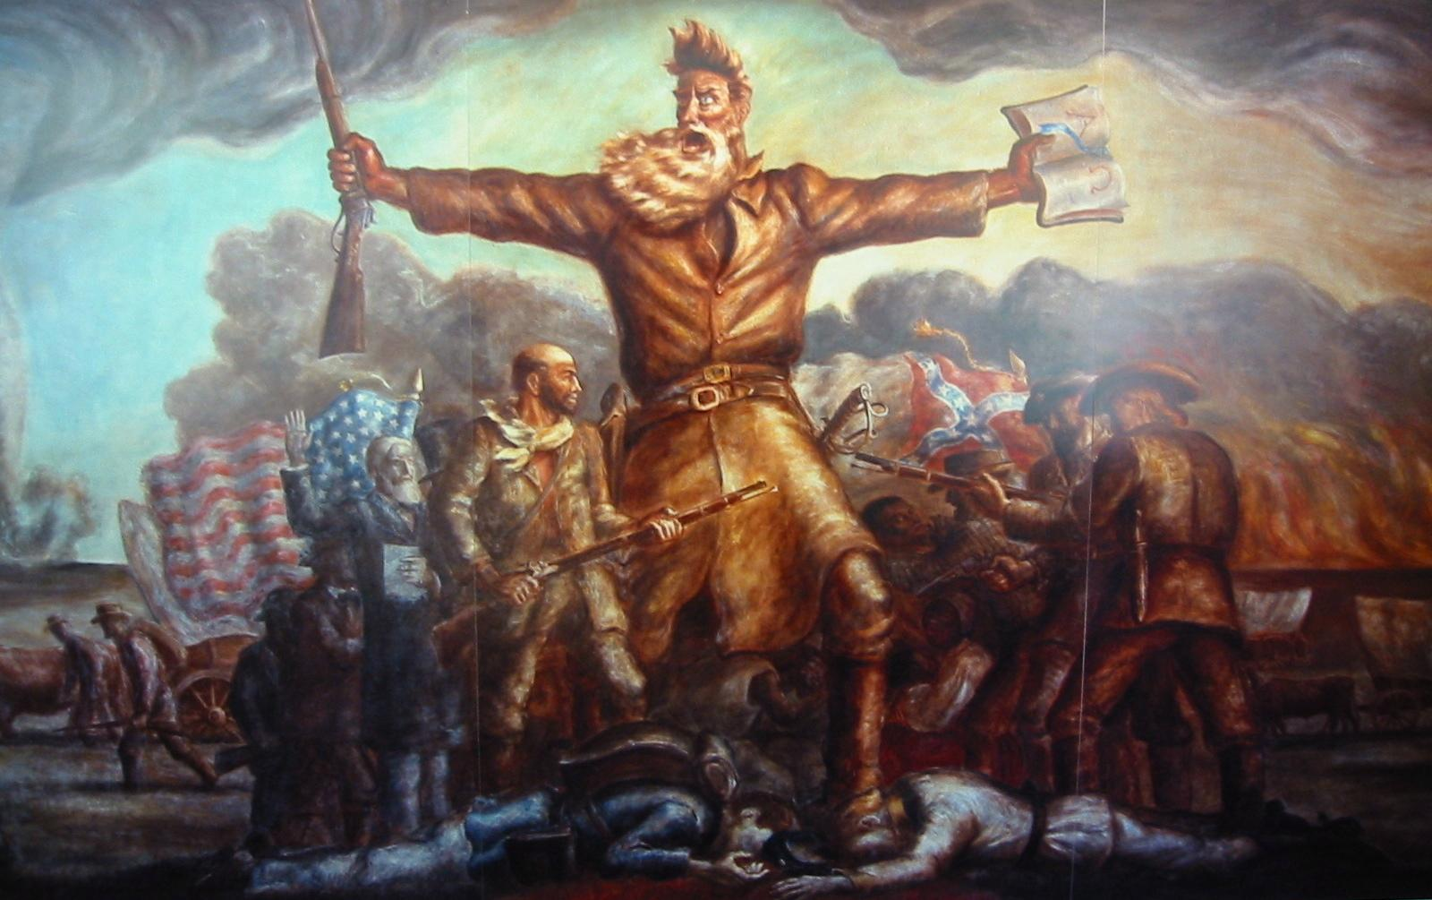
Chapter 23: “Will’s Quest”
barbarian
an uncivilized person
Example: Pa disagreed with the way
John Brown believed slavery should be abolished, so he called John Brown a barbarian.
John Brown looks like a barbarian in this picture.

Slide 48
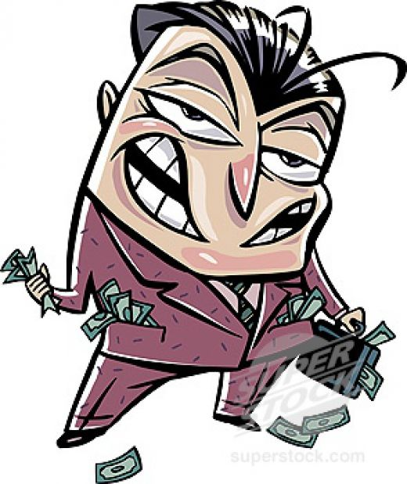
Chapter 24: “I’m Melting! I’m Melting!”
unscrupulous
not having the mind to do the
right thing
Example: Pa helped Solomon get free from the unscrupulous man in Missouri who claimed Solomon was his slave.
The unscrupulous man stole money from unsuspecting people.

Slide 49
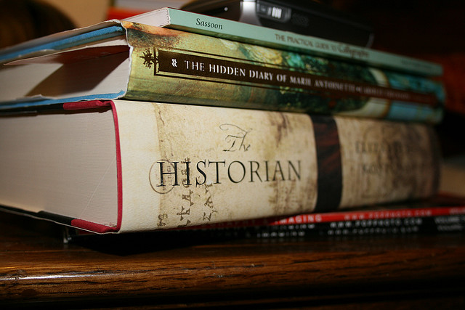
Chapter 24: “I’m Melting! I’m Melting!”
historian
an expert in history
Example: Dana’s dad was an historian and loved to read and study about past times.
An historian studies people and times of the past..

Slide 50
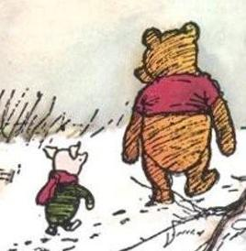
Chapter 25: “All Alone”
sidled
to move sideways
Example: Rebeccas was scared when Marshal Fain came to their home, so she sidled over to James for protection.
Piglet sidled up behind Winnie the Pooh.

Slide 51
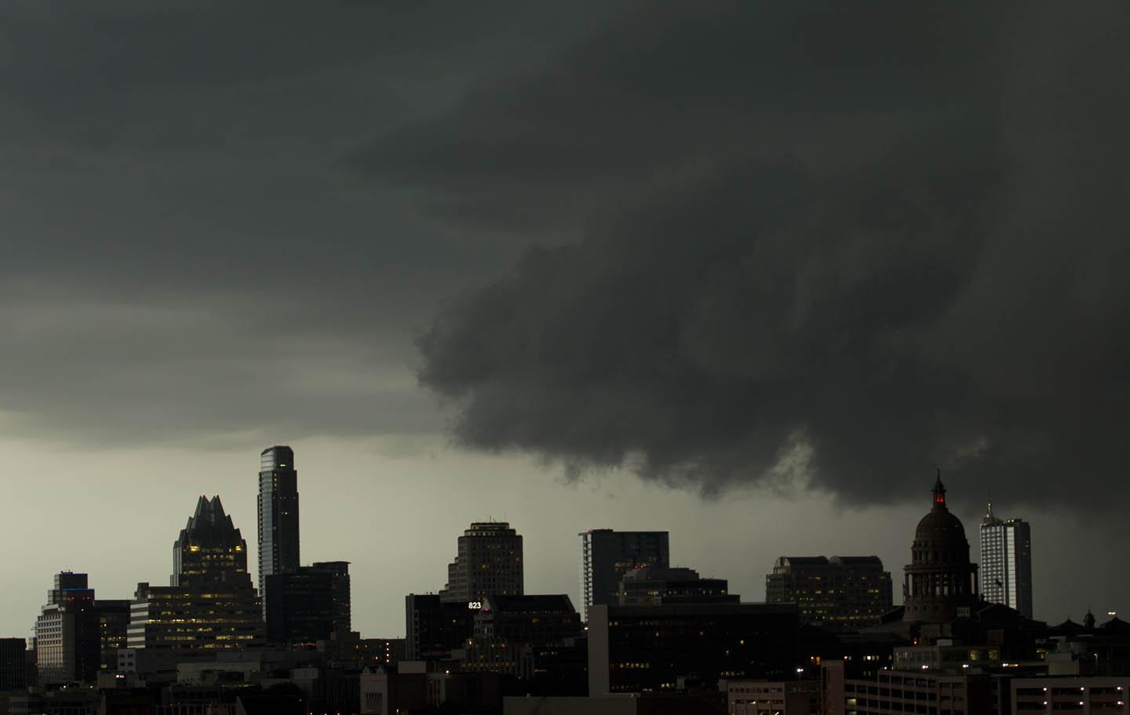
Chapter 25: “All Alone”
loomed
to appear in a large form
Example: Marshal Fein loomed in the doorway of the Weaver home.
The dark clouds loomed over the city..

Slide 52
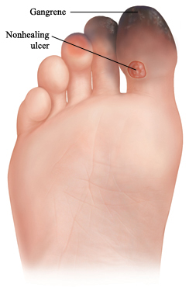
Chapter 26: “Hog Slaughter”
gangrene
death of soft tissue on the body due to
lack of circulation.
Example: When Miz Lizbet arrived at the Weaver home, James noticed she had gangrene when she removed her shoes.
Gangrene is caused by lack of circulation to the extremities.

Slide 53
Chapter 26: “Hog Slaughter”
fetched
to go get and bring back
Example: James ran and fetched Miz Lizbet some hot water.
The black lab fetched the yellow tennis ball after his master threw it in the backyard.

Slide 54
Chapter 27: “The Funeral”
preservation
to keep from decay
Example: Dr. Baxi was able to determine the year of Miz Lizbet’s death by the degree of preservation of her body.
The preservation of very old documents takes tremendous care.

Slide 55
Chapter 27: “The Funeral”
surmise
to think or infer without real evidence
Example: Dr. Baxi surmised Miz Lizbet’s body was well-preserved due to the cold winter of 1856.
To surmise, you need to put on your thinking cap to come to a conclusion.

Slide 56
Chapter 28: “The Return of Marshal Fain”
pewter
plate or kitchen utensils made from the
alloy of pewter
Example: James stirred the liquid in the boiling pot with Ma’s pewter ladle.
Pewter kitchen utensils were very common during the mid-1800’s.

Slide 57
Chapter 28: “The Return of Marshal Fain”
doilies
any small, ornamental mat, as of
embroidery or lace
Example: Marshal Fain became suspicious there was a Negro woman at the Weaver’s house because there were doilies on the table while Ma was gone to Boston.
Doilies can be used to decorate tables.

Slide 58
Chapter 29: “Up to the Tower”
unraveling
to free from complication or mystery
Example: Dr. Baxi felt the journal was not useful in closing the case of Miz Lizbet and how she died. He felt there were still unraveling ends.
The mystery of Miz Lizbet’s death was unraveling.

Slide 59
Chapter 29: “Up to the Tower”
leverage
to exert power
Example: Dana had a hard time gaining leverage in order to save Jeep when he fell through the floor.
The rescuers gained leverage on the dog by placing straps around his body.

Slide 60
Chapter 30: “Amen”
clunked
the sound of an object hitting a hard
surface
Example: Because Miz Lizbet was sick with fever and extremely restless, her cot clunked on the floor as she moved about.
The old and rusty car clunked along the road.

Slide 61
Chapter 30: “Amen”
bondage
the act of slavery
Example: Miz Lizbet had helped many slaves escape the chains of bondage when she helped them find their way North.
The man is asking to be free from the bondage of slavery.

Slide 62
Chapter 31: “Written in Stone”
dignitaries
people who hold high rank or office
Example: Some important dignitaries attended the reopening of Wolcott Castle.
Grant and Lee were considered dignitaries of the Union and Confederacy.

Slide 63
Chapter 31: “Written in Stone”
embedded
to be fixed in a surrounding object or
mass
Example: Jeep found a granite plaque embedded in the earth as a sign of memory to someone who had died.
The gravestone was embedded into the ground surrounding the base of the tree.

