Slide 1
World War I (The Great War) 1914-1918 Competition was the main reason why WW1 started; the need for power, wealth, land, and the pride that went with these factors.
Important Vocabulary

Slide 2
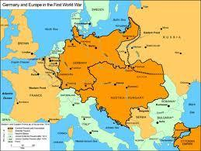
nationalism
Germany is
more important
than
any other
country!
the doctrine that national interest, security, etc. are more important than international considerations
The interests of
Austria-Hungary
are more
important than
any other
country!

Slide 3
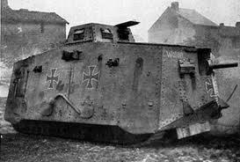
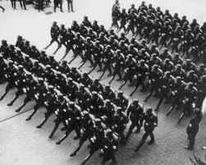
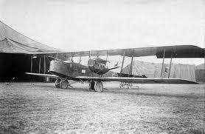
militarism
the policy of maintaining a strong military organization in aggressive preparedness for war

Slide 4
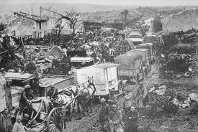
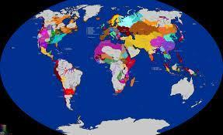
imperialism
the policy and practice of seeking to dominate the economic or political affairs of underdeveloped areas or weaker countries

Slide 5
The three “isms” that led to WWI.
N-nationalism
M-militarism
I-imperialism

Slide 6
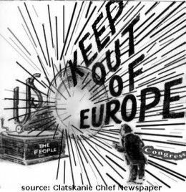
The United States practiced a policy of isolationism at this time.
The United States had a policy of isolationism from 1914-1917.
isolationism--
belief in the
opposition of the
involvement of
his or her own
country in
international
alliances,
agreements, etc.

Slide 7
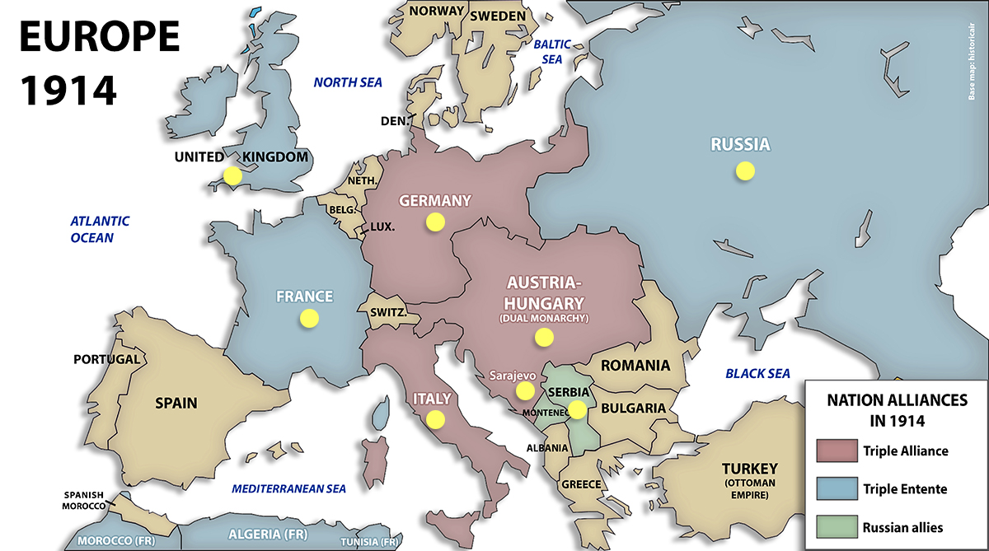
alliance
a close association for a common objective, as of nations, political parties, etc.

Slide 8
How can you remember what caused WWI?
M-militarism
A-alliances
I-imperialism
N-nationalism

Slide 9
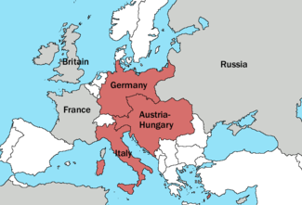
Triple Alliance (AKA Central Powers)
formed in 1882; an alliance between Germany and Austria-Hungary; first included Italy, but Italy withdrew;

Slide 10
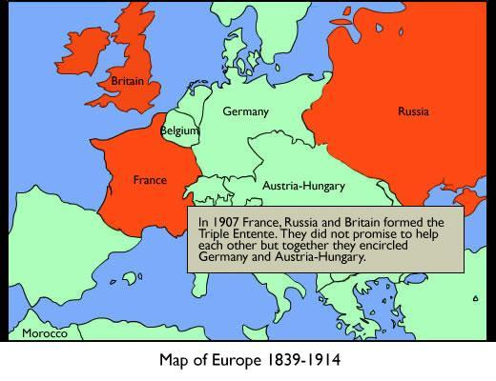
Triple Entente (AKA Allied Powers)
an alliance between Britain and Russia and France;

Slide 11
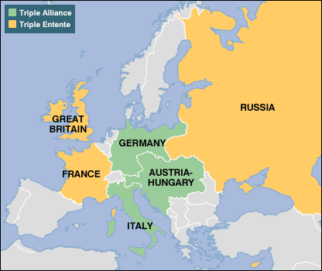
Secret Alliances
Triple Alliance (1882) Triple Entente (1907)
Germany Britain
Austria-Hungary France
Italy (later withdrew) Russia

Slide 12
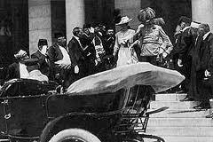
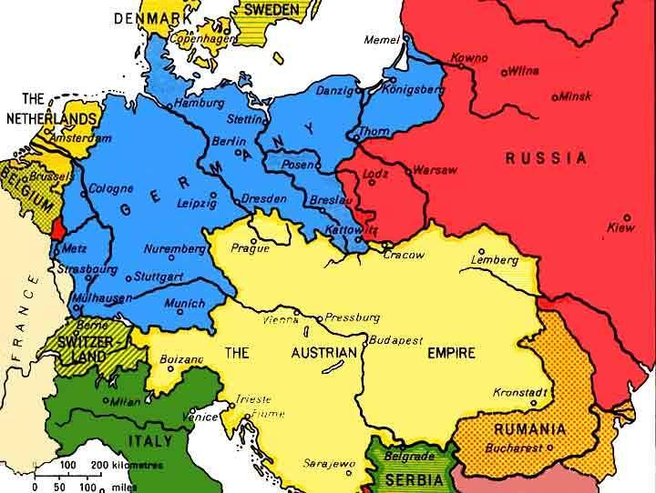
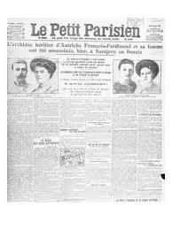
Assassinate-to murder high officials for political or religious reasons
The Archduke of Austria (Franz Ferdinand and his wife) are assassinated in the city of Sarajevo in the country of Bosnia in June, 1914.
Bosnia was a colony of Austria-Hungary

Slide 13
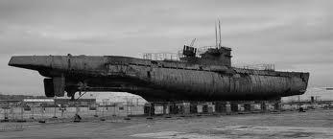
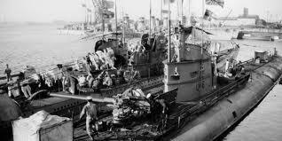
U-boat
a German submarine

Slide 14
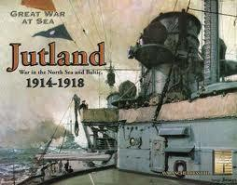
blockade
a shutting off of a port or region of a belligerent state by the troops or ships of the enemy in order to prevent passage in or out in time of war

Slide 15
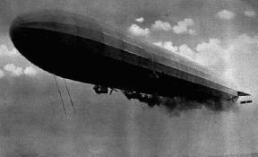
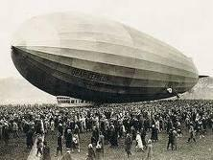
Zeppelin
any rigid airship: commonly used from 1900 to 1937
Proved to be an ineffective weapon

Slide 16
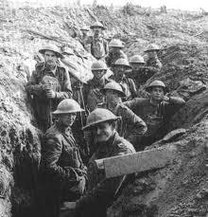
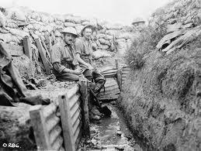
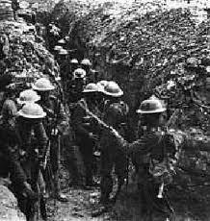
trench warfare
Warfare fought in man-made trenches. Soldiers slept, ate, fought, and died in these open tunnels.

Slide 17
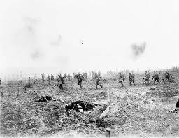
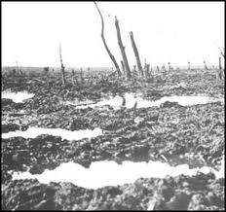
No-man’s land
The open area between enemy trenches
Usually contained enemy mines

Slide 18
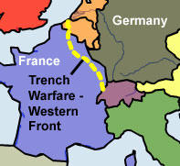
stalemate
Any unresolved situation
in which further action is
impossible or useless;
deadlock; draw.
Neither the Allied or
the Central Powers
were able to gain
land on their enemy.
This lasted most of
the war.

Slide 19
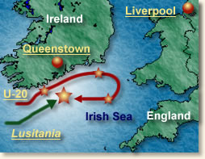
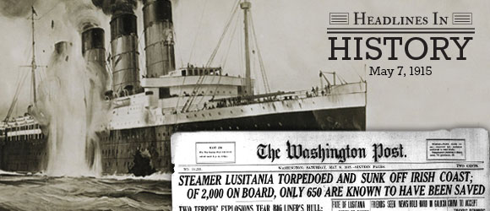
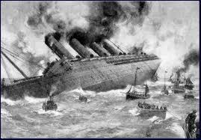
U.S.S. Lusitania
A British passenger ship that
was sunk off the coast of Ireland by a German u-boat. (May 7, 1915)

Slide 20
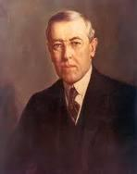
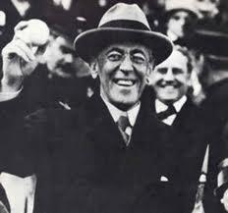
Woodrow Wilson
President of the United States during WWI

Slide 21
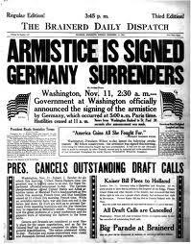
armistice
A peace
agreement

Slide 22
Wilson’s 14 Points
The 14 points set forward by President Wilson to assist with the conditions after the war

Slide 23
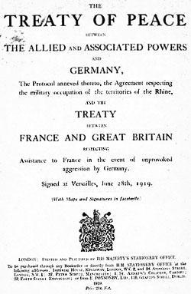
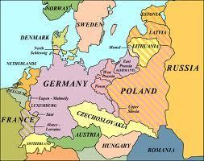
Treaty of Versailles
the document signed in Versailles, France that set the terms for post-war Europe and Germany

Slide 24
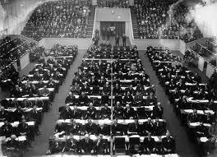
League of Nations
An organization formed at the end of WWI to prevent future wars; the U.S. DID NOT join, even though President Wilson wanted to be a part of it.

